Slide 1
Cloud Scale Machine Learning
Advanced Experimentation Techniques in Azure Machine Learning service

Slide 2
Preamble – The Agenda
An Overview of Machine Learning
Lab – Hands on with scikit-learn and TensorFlow
Understanding Azure Machine Learning service
Lab – Your First Machine Learning Experiment in the Cloud
Advanced Experimentation Techniques in Azure Machine Learning service
Lab – Hands-on Advanced Experimentation in Azure Machine Learning service
The Intersection of Data Science and DevOps
Lab – Automating your Machine Learning Pipeline in the Cloud

Slide 3
Preamble – The Agenda
An Overview of Machine Learning
Lab – Hands on with scikit-learn and TensorFlow
Understanding Azure Machine Learning service
Lab – Your First Machine Learning Experiment in the Cloud
Advanced Experimentation Techniques in Azure Machine Learning service
Lab – Hands-on Advanced Experimentation in Azure Machine Learning service
The Intersection of Data Science and DevOps
Lab – Automating your Machine Learning Pipeline in the Cloud

Slide 4


Preamble – Some Initial Thoughts

Slide 5

Preamble – Some Initial Thoughts
https://github.com/cloudscaleml/

Slide 6
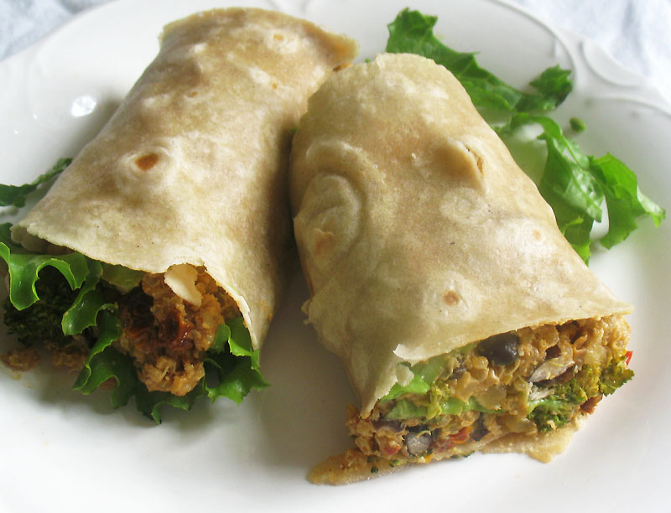

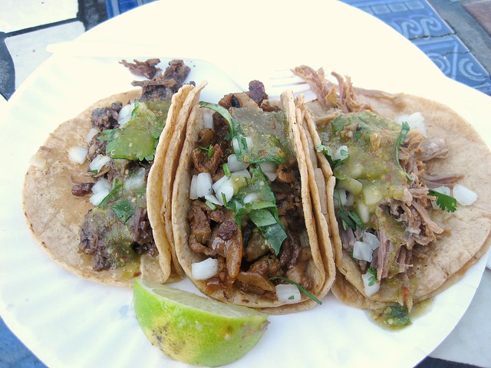
Preamble – What are we making?
burrito
tacos

Slide 7
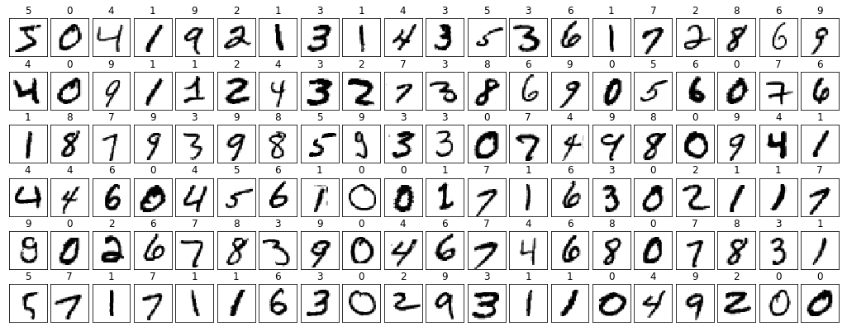
Notes:
Here are two examples of the training images we’ll be working with.
The first image is labelled as the digit “two”.
The second is labelled as the digit “one”.
TODO: Yann Lecun reference??

Slide 8
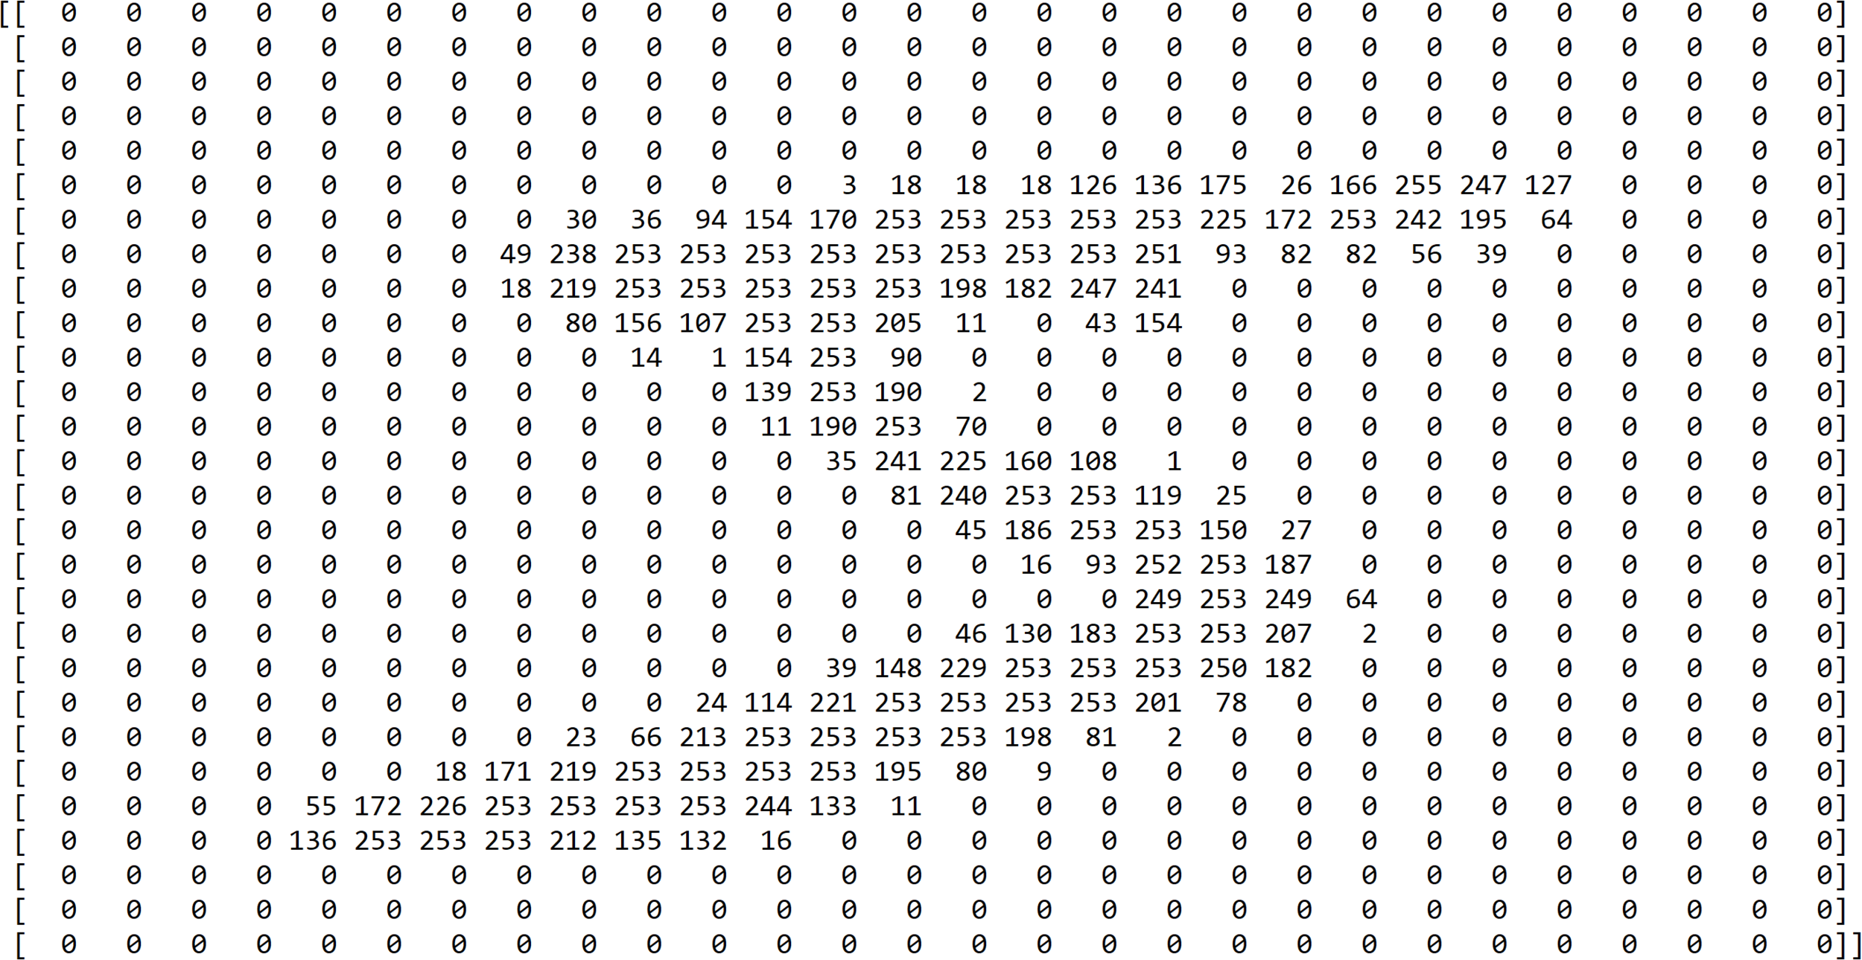

Slide 9
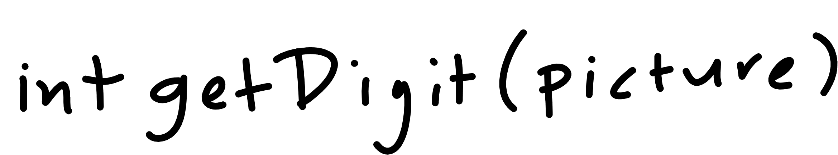

Slide 10

Notes:
Cover the fact that ML uses data to make its own functions

Slide 11
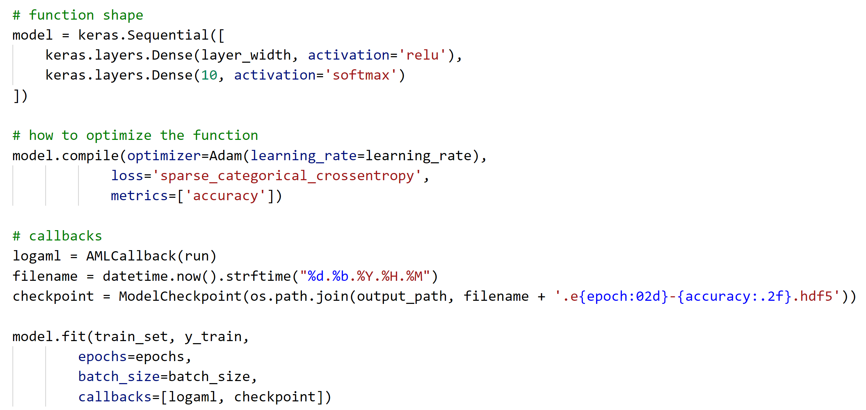

Slide 12
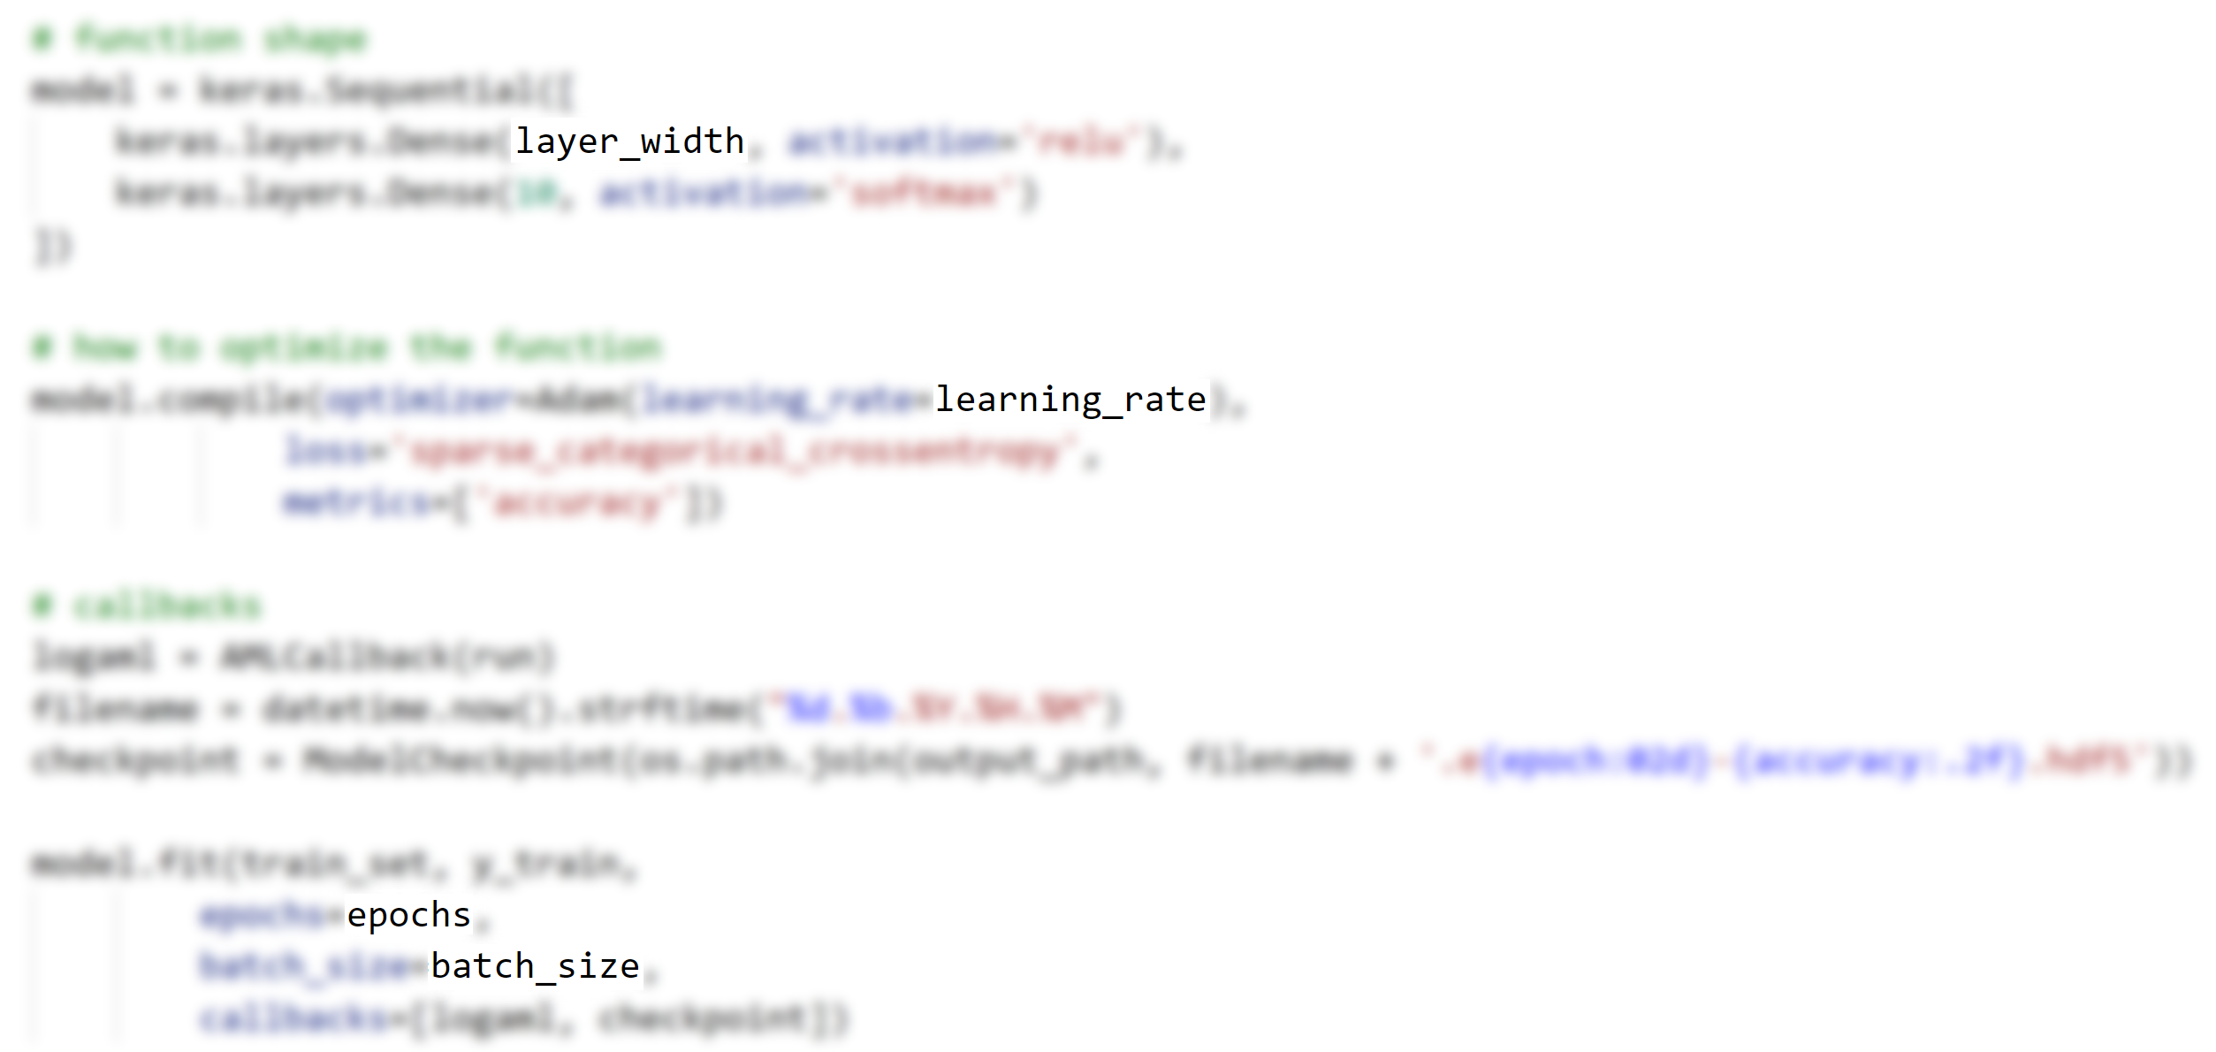

Slide 13
An Example
…to help motivate hyperparameters

Slide 14
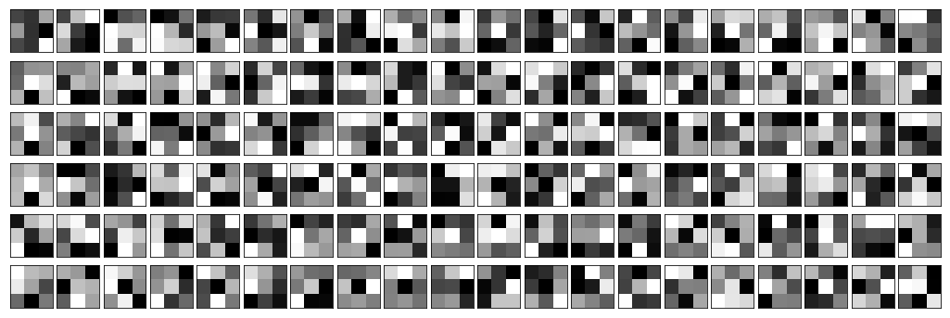
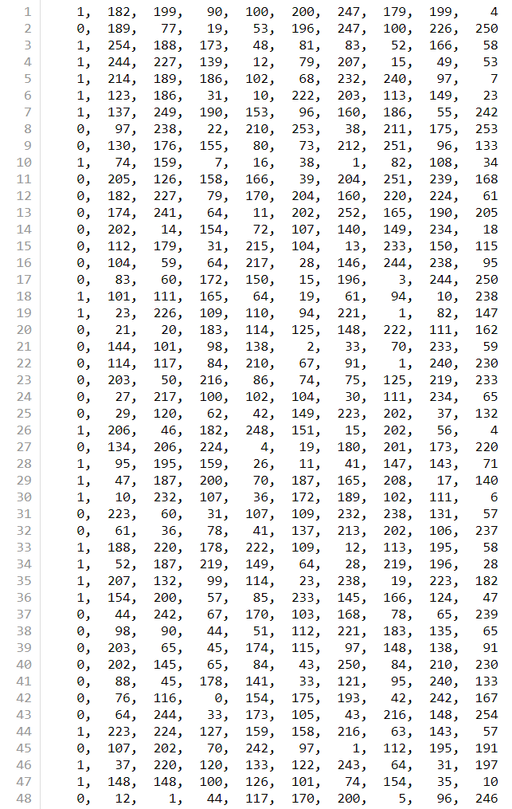

Slide 16
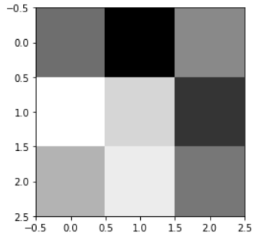
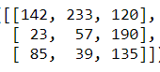
[142, 233, 120, 23, 57, 190, 85, 39, 135]

Slide 17
[ 1, 1, 1, 0, 0, 0, -1, -1, -1]
[142, 233, 120, 23, 57, 190, 85, 39, 135]
236

Slide 18
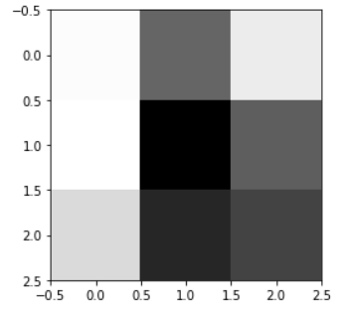
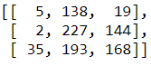
[5, 138, 19, 2, 227, 144, 35, 193, 168]

Slide 19
[ 1, 1, 1, 0, 0, 0, -1, -1, -1]
[5, 138, 19, 2, 227, 144, 35, 193, 168]
-234

Slide 20
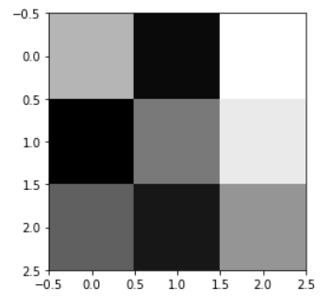

Slide 22
top
middle
bottom

Slide 23
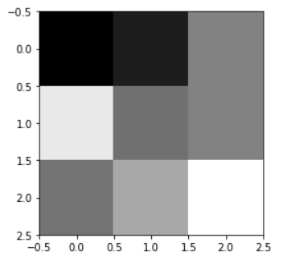
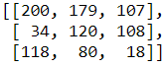

Slide 25


Slide 27
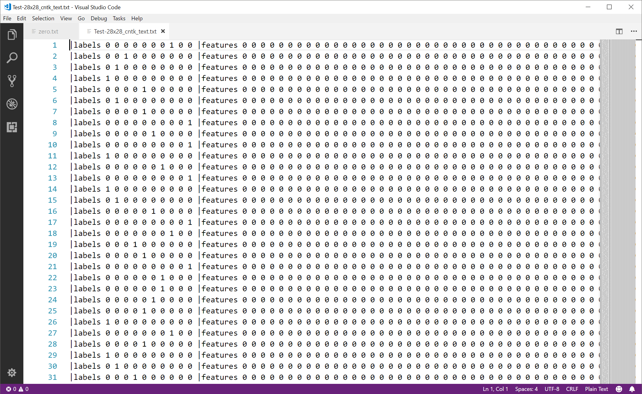

Slide 34
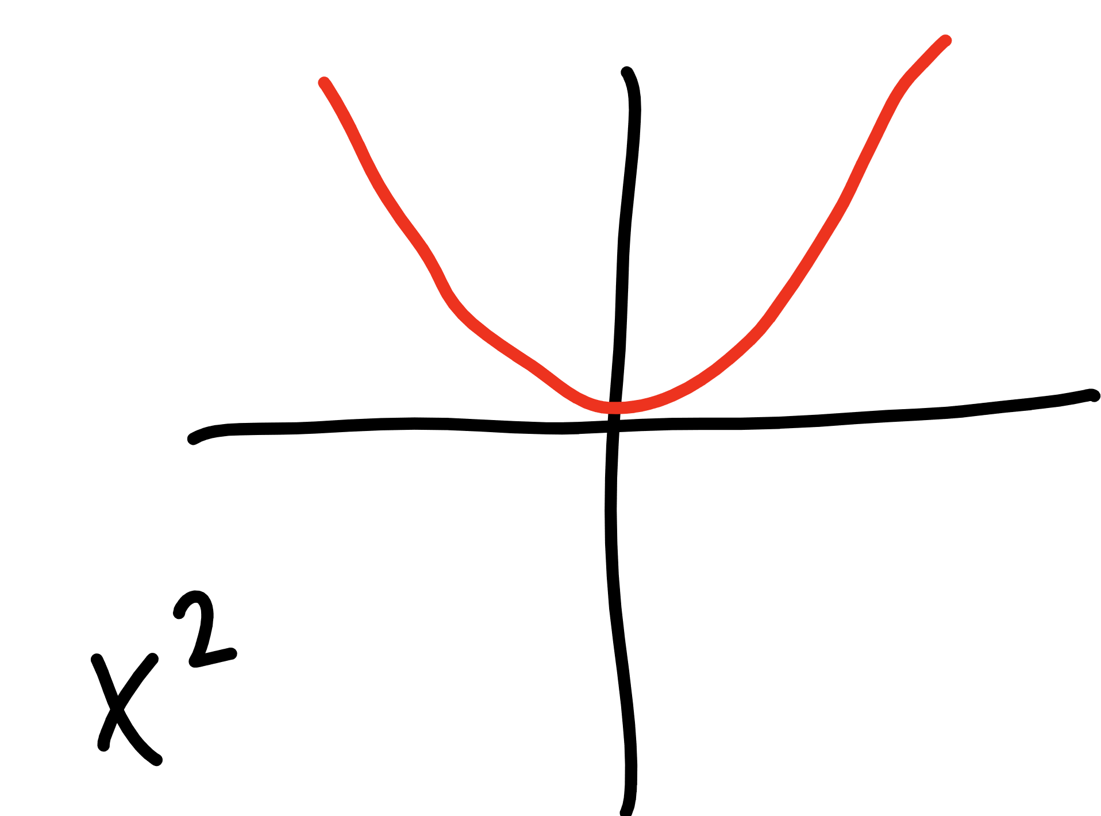

Slide 35
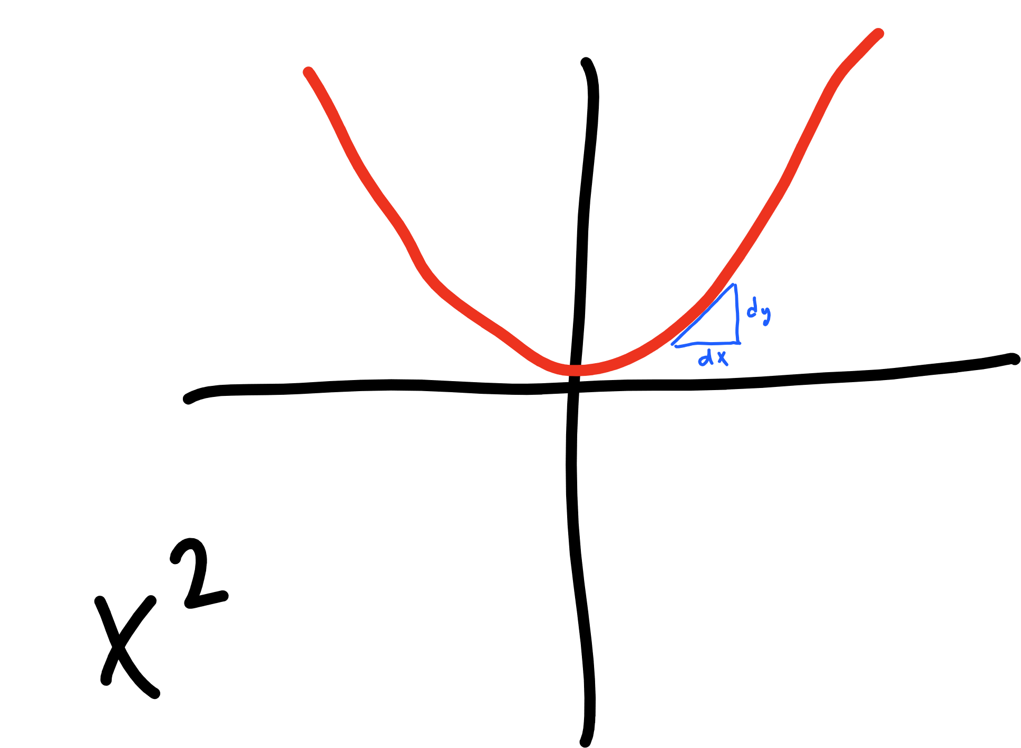

Slide 36
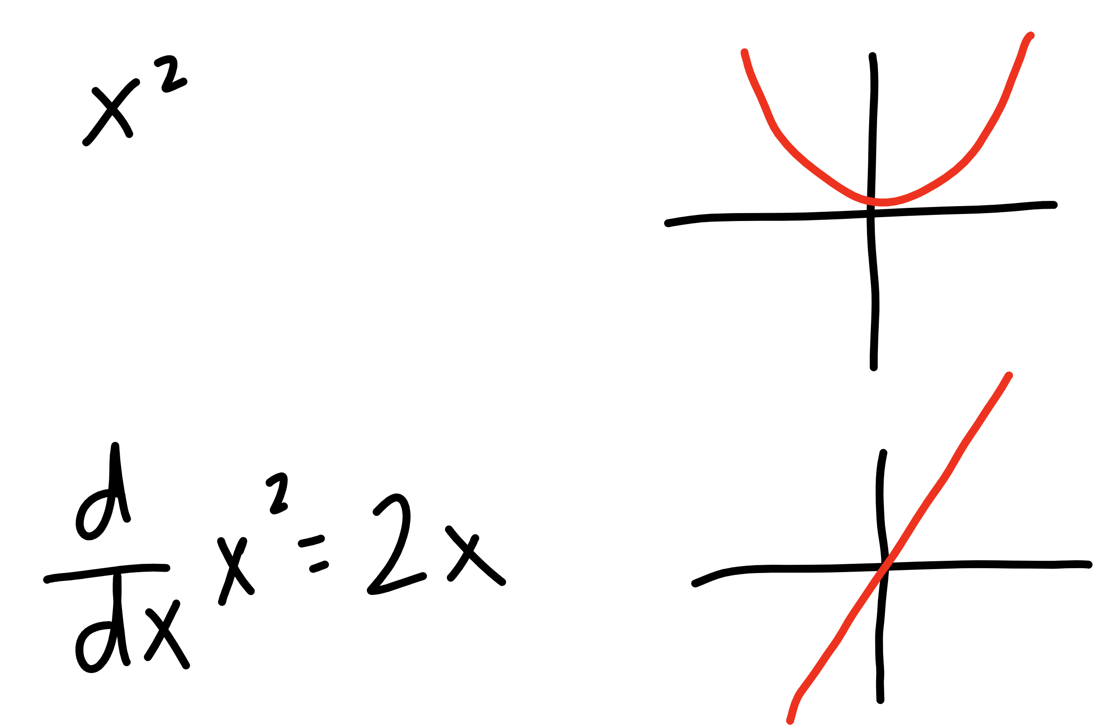

Slide 37
learning
rate
updated W
derivative of
cost function
current W

Slide 38
learning
rate
gradient of
cost function
updated W
current W

Slide 39
learning
rate
gradient of
cost function
updated W
current W

Slide 40
learning
rate
gradient of
cost function
updated b
current b

Slide 42


Slide 43
[ 1, 1, 1, 0, 0, 0, -1, -1, -1]
[5, 138, 19, 2, 227, 144, 35, 193, 168]
-234

Slide 44
top
middle
bottom

Slide 45



Slide 46
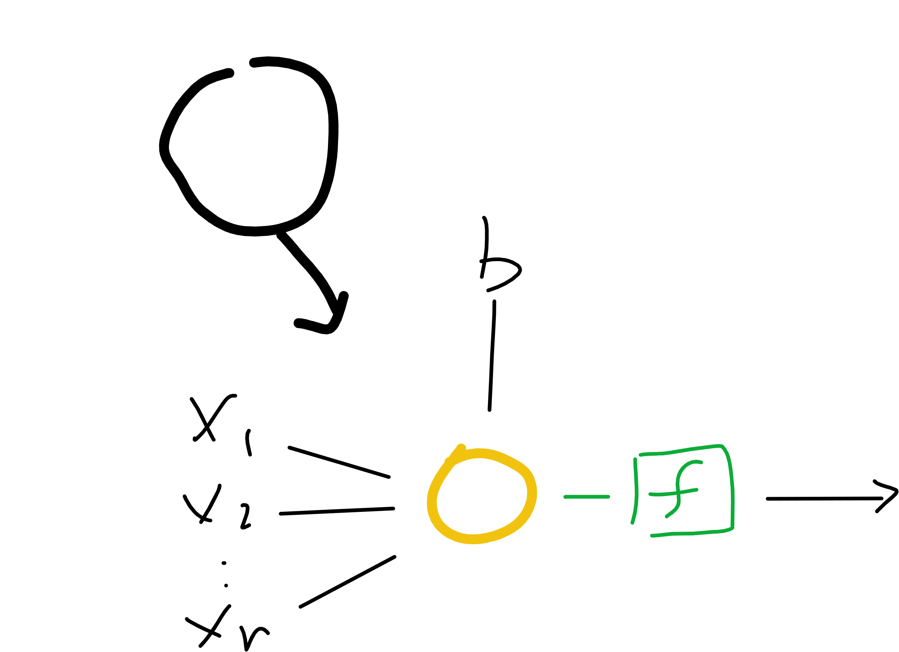
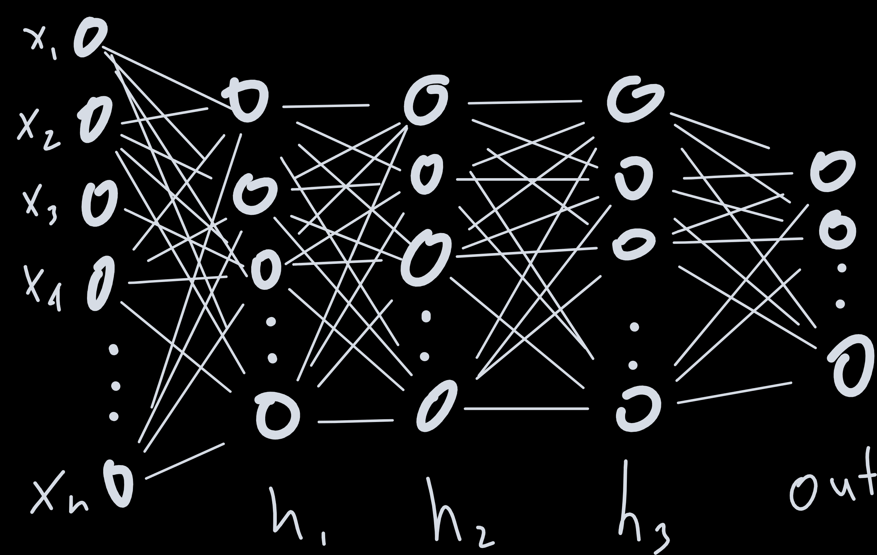
Notes:
Proof by induction

Slide 48
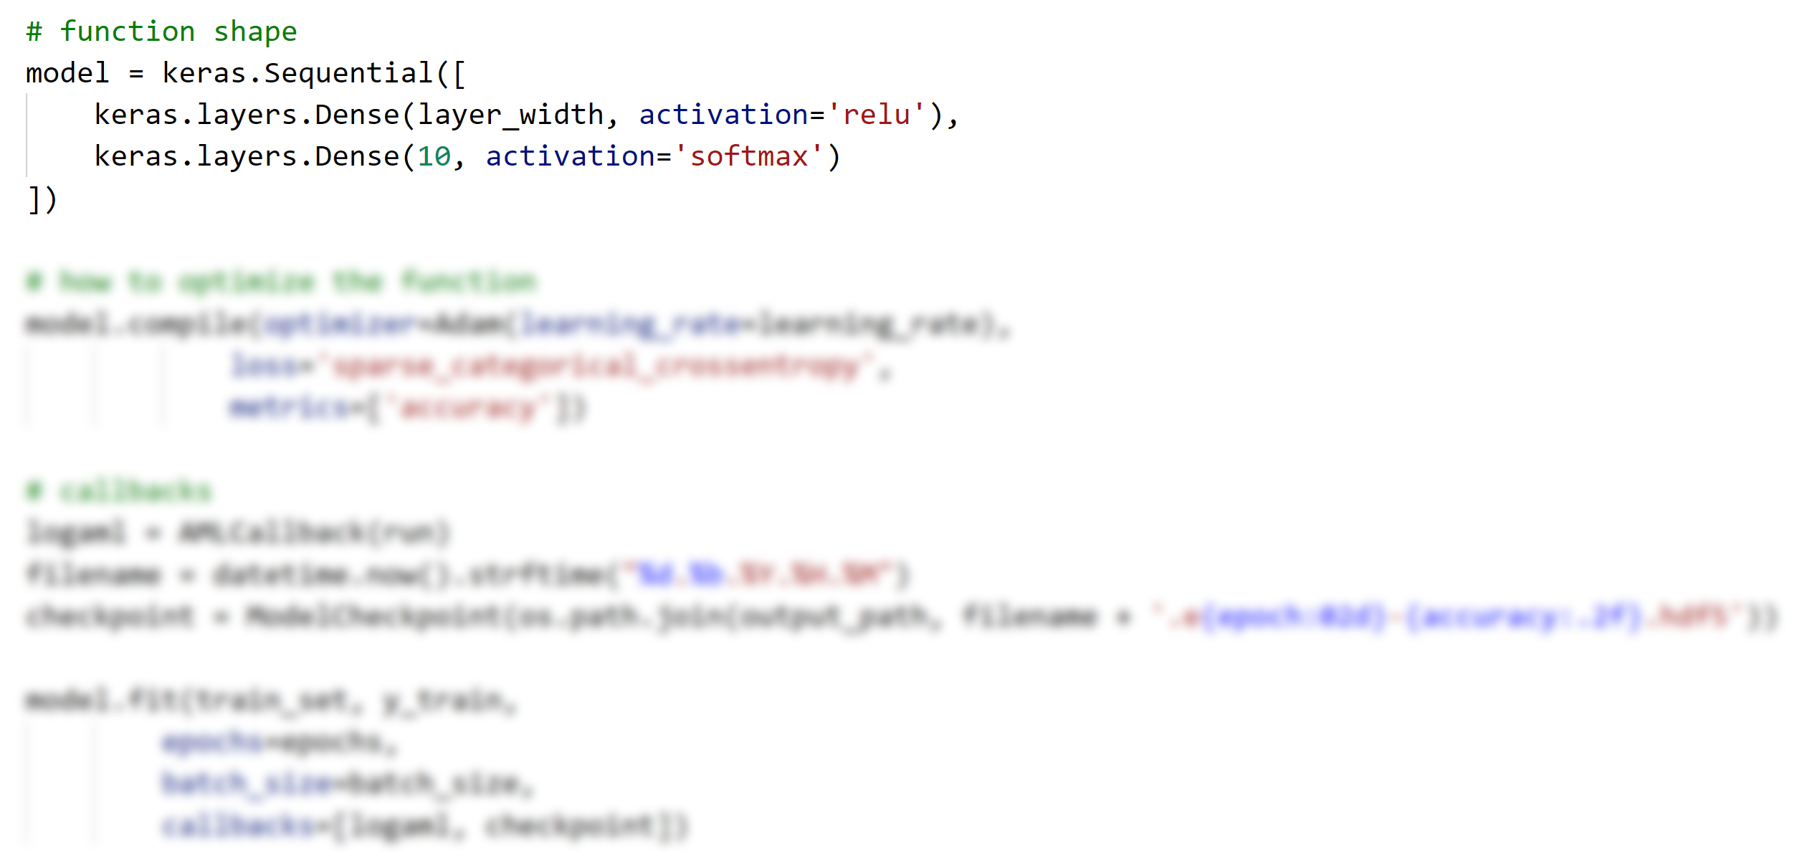

Slide 50

Hyperparameter Tuning
Do I just make a for loop over all hyperparameters?

Slide 51
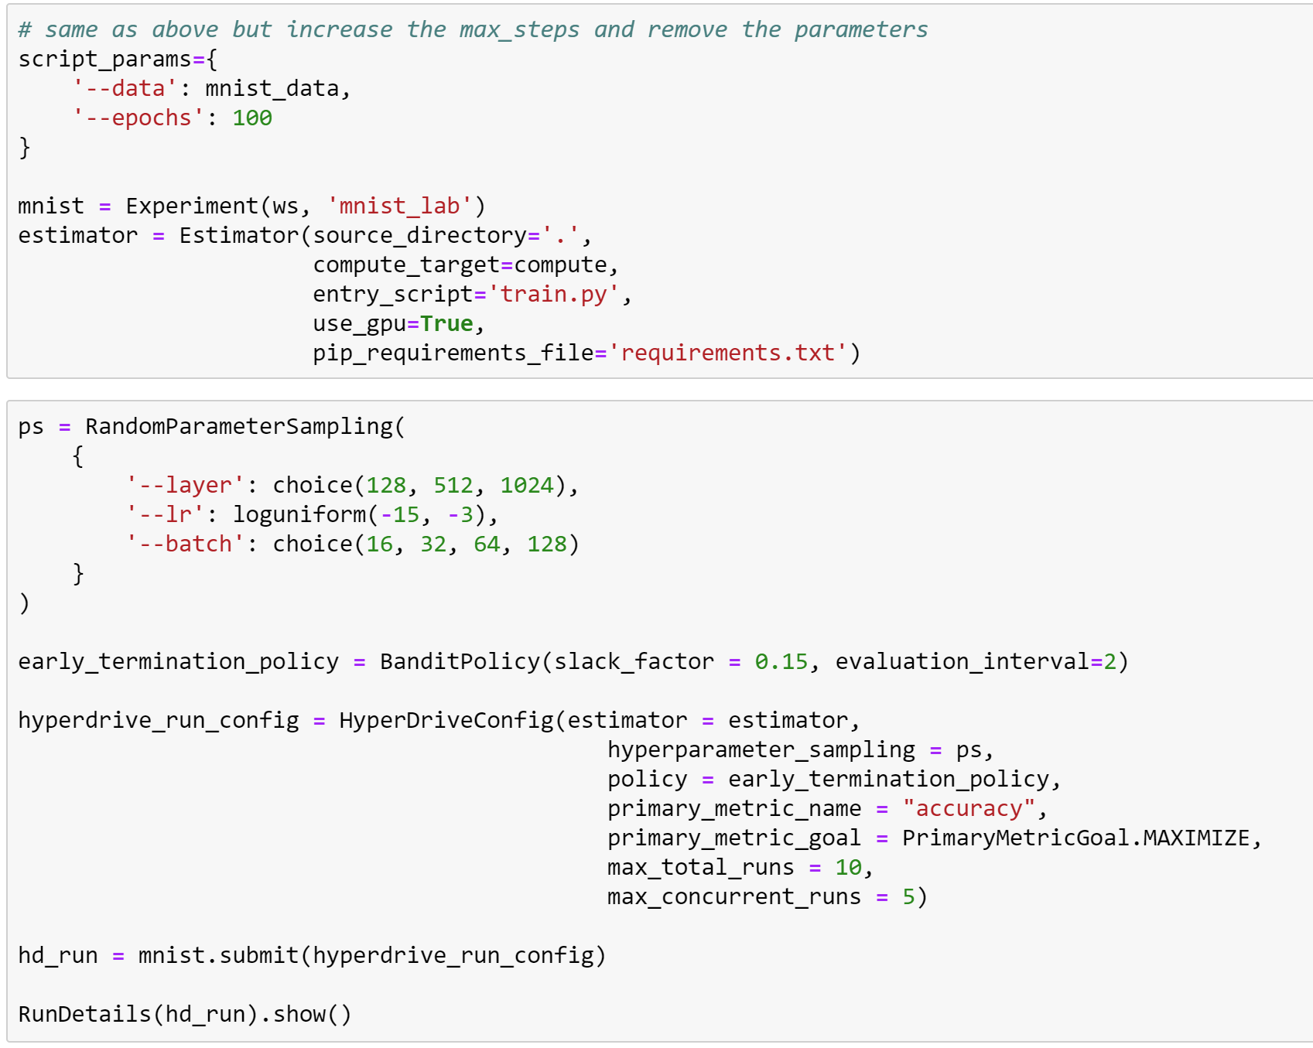

Slide 52
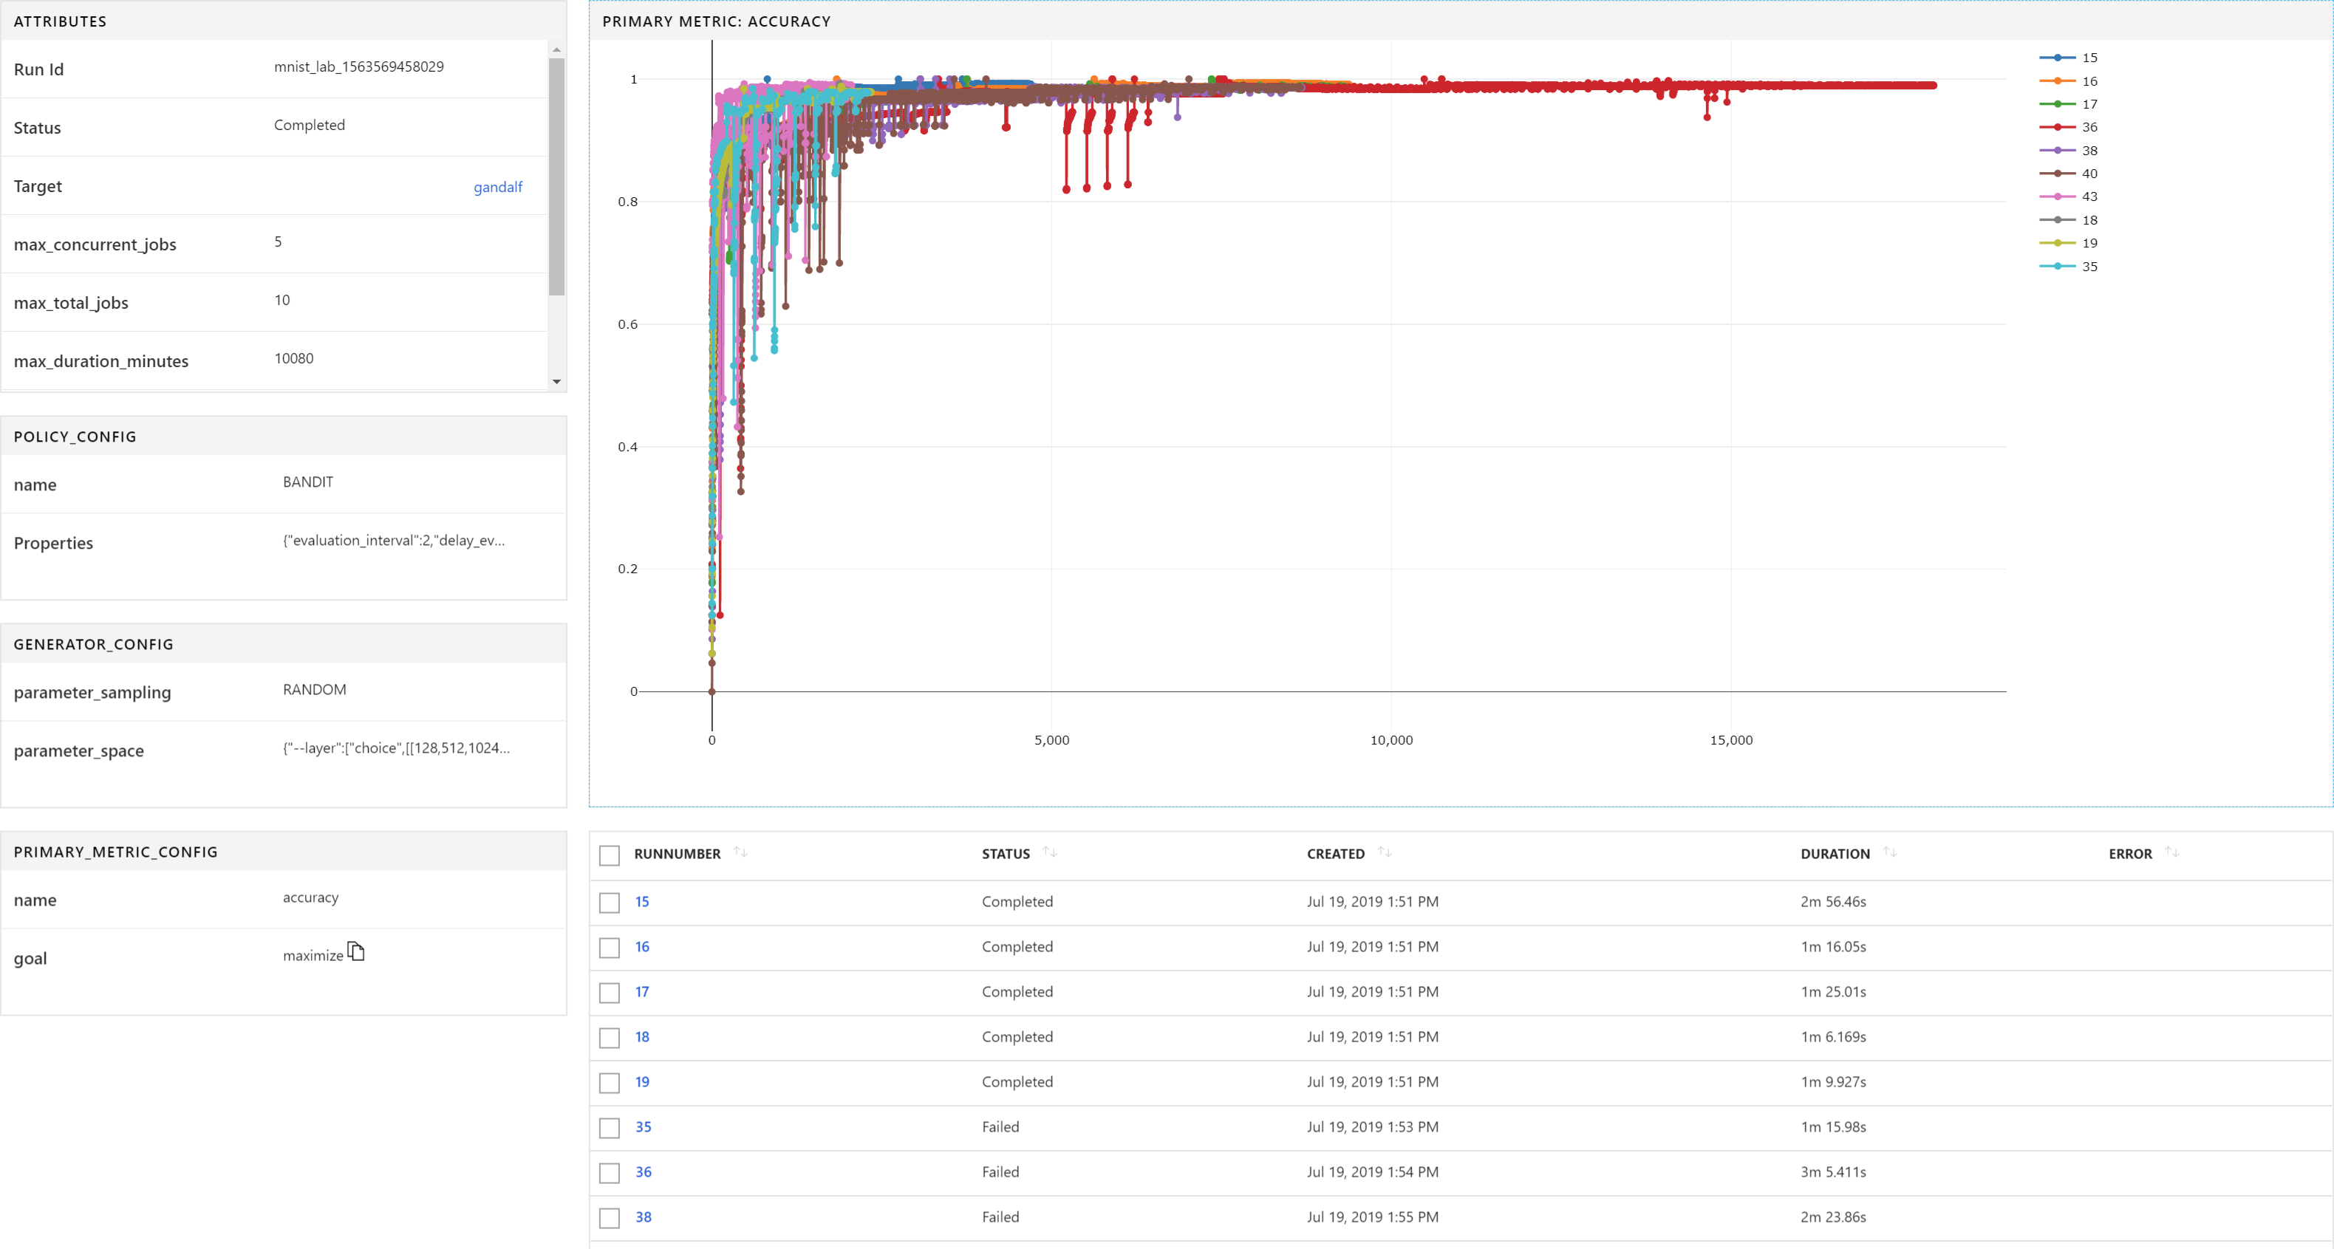

Slide 53
Automated ML

Slide 54
Azure Machine Learning
Automated machine learning
How much is this car worth?
Notes:
Our approach to ML frameworks is simple.
We give customers the flexibility to choose their deep learning framework, without getting locked one framework.
To help with this we’ve created a community project in partnership with Facebook that allows customers to train in one framework and use another one for inference
Now, let me move to the ML services on Azure

Slide 55
Model creation is typically a time consuming process
Which features?
Which algorithm?
Which parameters?
Mileage
Condition
Car brand
Year of make
Regulations
…
Gradient Boosted
Nearest Neighbors
SVM
Bayesian Regression
LGBM
…
Parameter 1
Parameter 2
Parameter 3
Parameter 4
…
Mileage
Gradient Boosted
Criterion
Loss
Min Samples Split
Min Samples Leaf
Others
Car brand
Year of make
30%
Model
Notes:
Our approach to ML frameworks is simple.
We give customers the flexibility to choose their deep learning framework, without getting locked one framework.
To help with this we’ve created a community project in partnership with Facebook that allows customers to train in one framework and use another one for inference
Now, let me move to the ML services on Azure

Slide 56
Model creation is typically a time consuming process
Track
Which features?
Which algorithm?
Which parameters?
Mileage
Condition
Car brand
Year of make
Regulations
…
Gradient Boosted
Nearest Neighbors
SGD
Bayesian Regression
LGBM
…
Criterion
Loss
Min Samples Split
Min Samples Leaf
XYZ
Mileage
Gradient Boosted
N Neighbors
Weights
Metric
P
ZYX
Condition
Nearest Neighbors
Car brand
Car brand
50%
Year of make
30%
Year of make
Model
Iterate
Notes:
Our approach to ML frameworks is simple.
We give customers the flexibility to choose their deep learning framework, without getting locked one framework.
To help with this we’ve created a community project in partnership with Facebook that allows customers to train in one framework and use another one for inference
Now, let me move to the ML services on Azure

Slide 57
Model creation is typically a time consuming process
Track
Which features?
Which algorithm?
Which parameters?
30%
50%
70%
30%
45%
50%
65%
95%
35%
10%
75%
20%
70%
30%
15%
Iterate
Notes:
Our approach to ML frameworks is simple.
We give customers the flexibility to choose their deep learning framework, without getting locked one framework.
To help with this we’ve created a community project in partnership with Facebook that allows customers to train in one framework and use another one for inference
Now, let me move to the ML services on Azure

Slide 58
Automated Machine Learning accelerates model development
Input
Intelligently test multiple models in parallel
Output
25%
Optimized model
25%
40%
Enter data
70%
25%
40%
70%
95%
95%
Define goals
25%
40%
70%
25%
40%
25%
70%
Apply constraints
40%
Notes:
Our approach to ML frameworks is simple.
We give customers the flexibility to choose their deep learning framework, without getting locked one framework.
To help with this we’ve created a community project in partnership with Facebook that allows customers to train in one framework and use another one for inference
Now, let me move to the ML services on Azure

Slide 59
Model Understanding
Feature Importance
model
Feature Importance
model
95%
70%
Mileage
Condition
Regulations
Year of make
Car brand
Mileage
Condition
Regulations
Year of make
Car brand
0
1
0
1
Enable model explain-ability for every automated ML iteration, not just the optimal model
Notes:
Explain the inner workings of machine learning by analyzing the ML pipeline and all involved steps
Analyze global feature importance on-demand before finalizing a model for deployment
Enable model explain-ability for every automated ML iteration, not just the optimal model

Slide 60
Automated ML
…what does it look like for our digit problem?

Slide 61
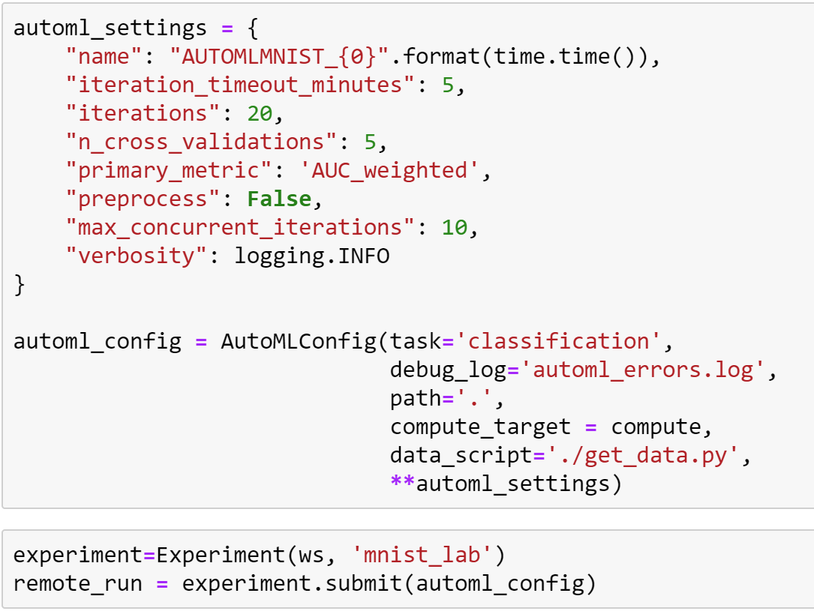
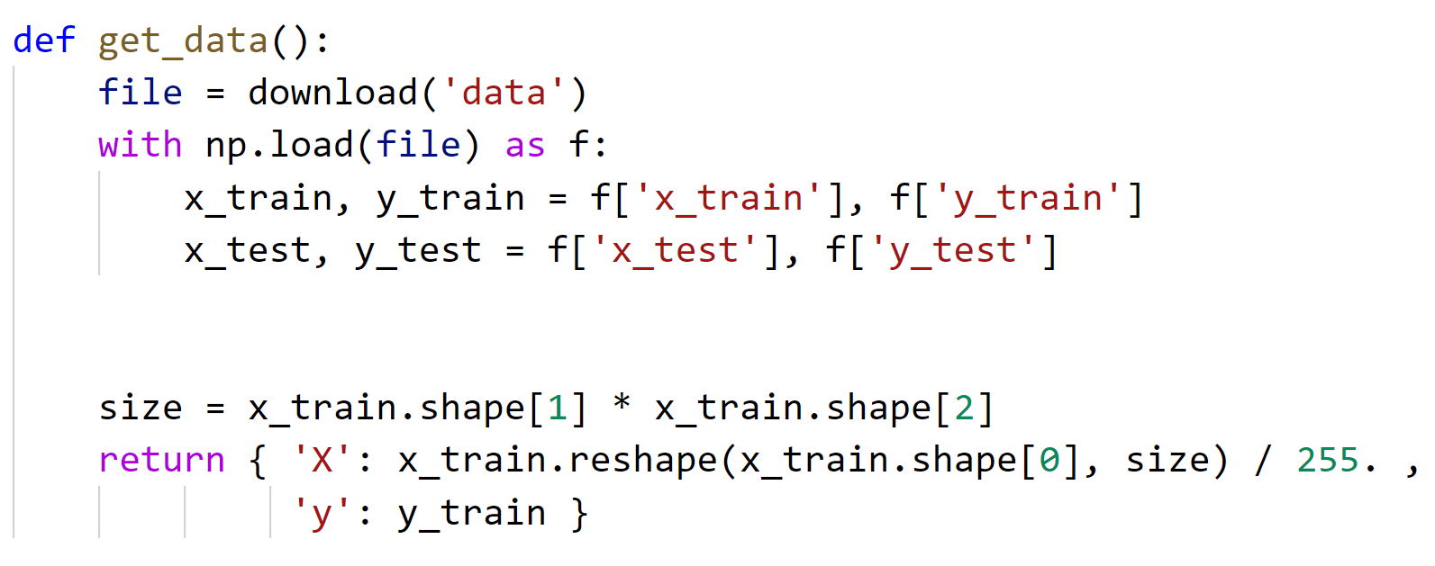

Slide 62
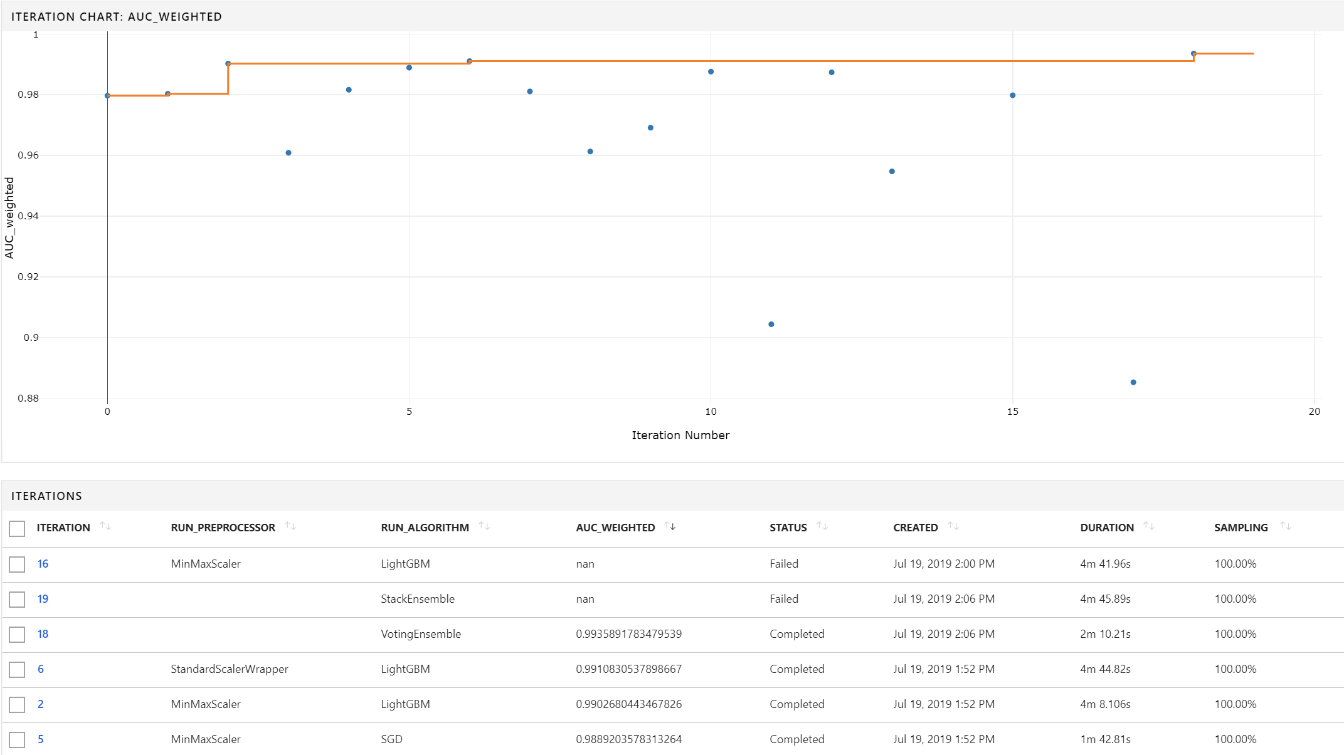

Slide 63
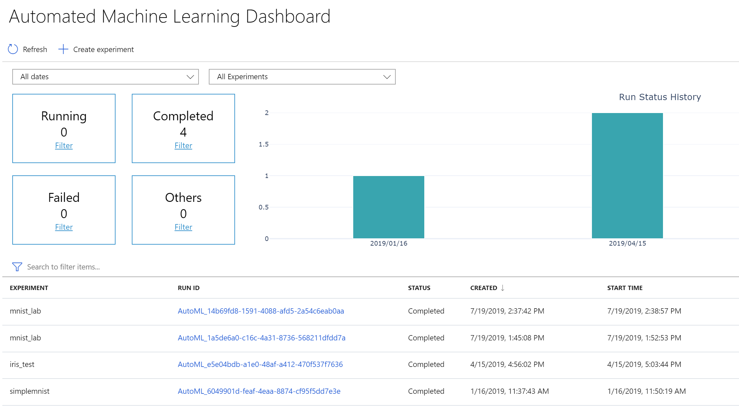

Slide 64
Advanced AML
Questions?

Slide 65

Azure ML Designer

Slide 66
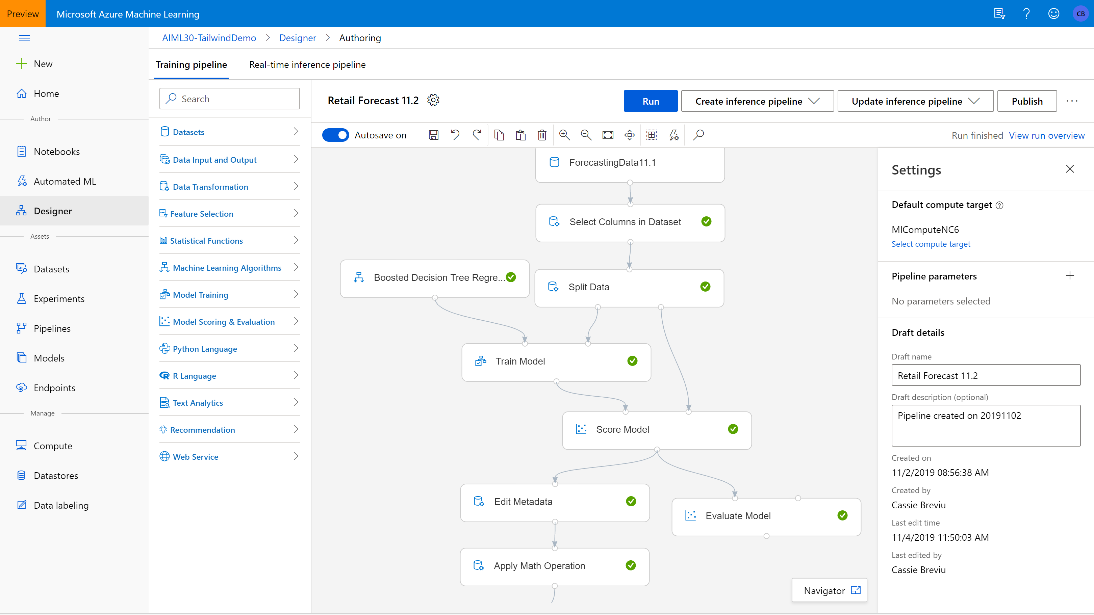

Slide 67
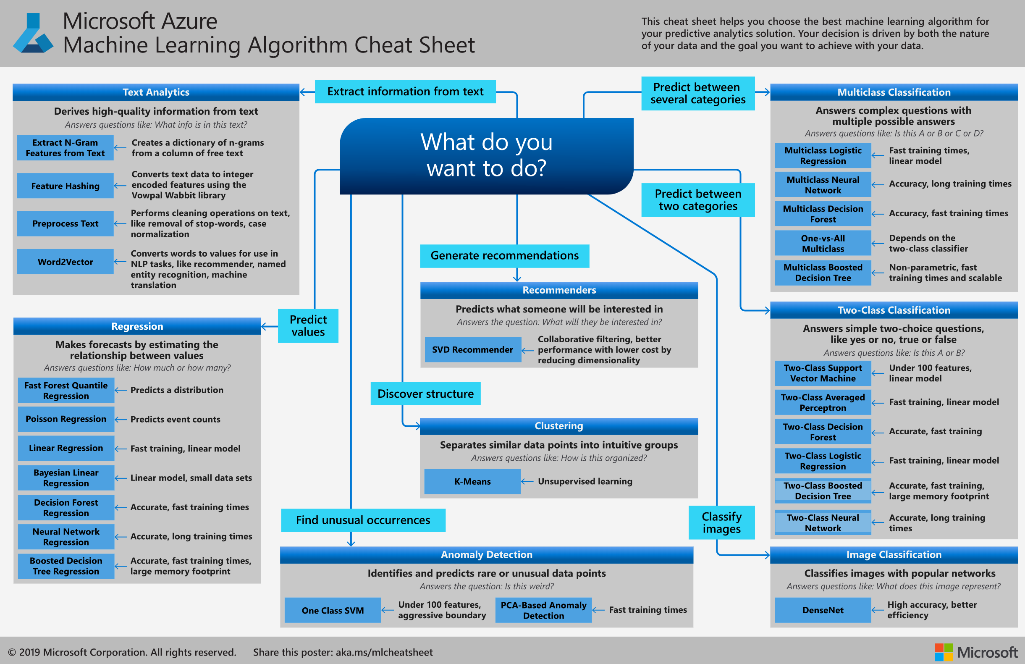

Slide 68
Lab
Hands-on Advanced Experimentation in Azure Machine Learning service

